Slide 1



Slide 2
Mixed Bag

Slide 3
Triangles

Slide 4
Quadrilaterals

Slide 5
Angles

Slide 6
Formulas

Slide 7
Circles

Slide 8
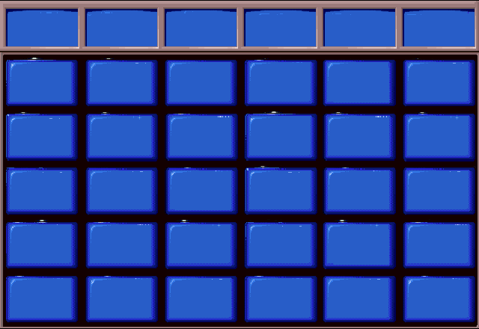
Mixed Bag
Triangles
Quadrilaterals
Angles
Formulas
Circles
$100
$100
$100
$100
$100
$100
$200
$200
$200
$200
$200
$200
$300
$300
$300
$300
$300
$300
$400
$400
$400
$400
$400
$400
$500
$500
$500
$500
$500
$500

Slide 9
The shortest
distance between
two points.

Slide 10
What is
a line?

Slide 11
This polygon has
three equal
sides.

Slide 12
What is an equilateral
triangle?

Slide 13
This polygon has
four equal sides, and
2 sets of equal angles.

Slide 14
What is a
rhombus?

Slide 15
a²+b²=c²

Slide 16
What is the
pythagorean
theorem?

Slide 17
When two polygons
are the same size
and shape.

Slide 18
What is
congruent?

Slide 19
A triangle having
a right angle.

Slide 20
What is a
right triangle?

Slide 21
A triangle having
two sides of
equal length.

Slide 22
What is an
isosceles triangle?

Slide 23
A triangle having
three sides of
different lengths.

Slide 24
What is a
scalene triangle?

Slide 25
A triangle with
angles less than
90 degrees.

Slide 26
What is an
acute triangle?

Slide 27
A triangle with
one angle measuring
greater than
90 degrees.

Slide 28
What is an
obtuse triangle?

Slide 29
The sum of all
angles in a
quadrilateral.

Slide 30
What is
360 degrees?

Slide 31
Four-sided
polygon
having all
right angles.

Slide 32
What is a
rectangle?

Slide 33
A four-sided
polygon with two
pairs of parallel
sides.

Slide 34
What is
a
parallelogram?

Slide 35
A four-sided
polygon having
exactly one pair
of parallel sides.

Slide 36
What is a trapezoid?

Slide 37
A four sided
polygon with all
equal sides, and all
equal angles.

Slide 38
What is a
square?

Slide 39
An angle
equaling
90 degrees.

Slide 40
What is a
right angle?

Slide 41
An angle that
is less than
90 degrees.

Slide 42
What is an
acute angle?

Slide 43
An angle greater
than 90 degrees, but
less than 180 degrees.

Slide 44
What is an
obtuse angle?

Slide 45
Two angles
that add up to
90 degrees.

Slide 46
What are
complementary
angles?

Slide 47
Two angles that
add up to
180 degrees.

Slide 48
What are
supplementary
angles?

Slide 49
Height x Width

Slide 50
What is area?

Slide 51
height x width x depth

Slide 52
What is
volume?

Slide 53
πr²

Slide 54
What is the
area of a circle?

Slide 55
Length+width+height

Slide 56
What is perimeter?

Slide 57
Daily
Double!!

Slide 58
2πr

Slide 59
What is the
perimeter of a circle?

Slide 60
A line segment
that has both
endpoints on a circle
and passes through
the center

Slide 61
What is
diameter?

Slide 62
The distance
around a circle?

Slide 63
What is
circumference?

Slide 64
A line segment
with both endpoints
on the circle.

Slide 65
What is
a chord?

Slide 66
A portion
of a circle.

Slide 67
What is
an arc?

Slide 68
A part of a circle
that is equal to one
half of the circle.

Slide 69
What is a
semi-circle?

